Slide 1


Masahiro Nakata
August 30th, 2023

Slide 2

Outline
Executive Summary
Introduction
Methodology
Results
Conclusion
Appendix

Slide 3
Executive Summary
Summary of methodologies
Data collection methodology:
Perform data wrangling
Perform exploratory data analysis (EDA) using visualization and SQL
Perform interactive visual analytics using Folium and Matplotlib
Perform predictive analysis using classification models
Summary of all results
Exploratory data analysis results
Interactive analytics demo in screenshots
Predictive analysis results

Slide 4
Introduction
Project background and context
SpaceX advertises Falcon 9 rocket launches on its website with a cost of 62 million dollars; other providers cost upward of 165 million dollars each, much of the savings is because SpaceX can reuse the first stage. Therefore if we can determine if the first stage will land, we can determine the cost of a launch. This information can be used if an alternate company wants to bid against SpaceX for a rocket launch.
Problems should be found answers
Predicting if the Falcon 9 first stage will land successfully.

Slide 5

Section 1

Slide 6
Methodology
Executive Summary
Data collection methodology:
By utilizing SpaceX API and Web Scraping
Perform data wrangling
By utilizing Pandas
Perform exploratory data analysis (EDA) using visualization and SQL
Perform interactive visual analytics using Folium and Matplotlib
Perform predictive analysis using classification models
By utilizing Scikit-learn

Slide 7
Data Collection
How data sets were collected.
SpaceX API
Web Scraping
Data collection process with key phrases and flowcharts
See subsequent slides

Slide 8
Data Collection – SpaceX API
Collecting the data through SpaceX API and making sure the data is in the correct format.
https://github.com/nakatama225/IBM_DS_Final_Project/
Flowchart in this process
Task 1: Request and parse the SpaceX launch data using the GET request
↓
Task 2: Filter the dataframe to only include Falcon 9 launches
↓
Task 3: Dealing with Missing Values

Slide 9
Data Collection - Scraping
Web scraping to collect Falcon 9 historical launch records from a Wikipedia page titled, List of Falcon 9 and Falcon Heavy launches.
https://github.com/nakatama225/IBM_DS_Final_Project/
Flowchart in this process
TASK 1: Request the Falcon9 Launch Wiki page from its URL
↓
TASK 2: Extract all column/variable names from the HTML table header
↓
TASK 3: Create a data frame by parsing the launch HTML tables

Slide 10
Data Wrangling
Performing some Exploratory Data Analysis (EDA) through Pandas to find some patterns in the data and determine what would be the label for training supervised models.
https://github.com/nakatama225/IBM_DS_Final_Project/
Flowchart in this process
TASK 1: Calculate the number of launches on each site
↓
TASK 2: Calculate the number and occurrence of each orbit
↓
TASK 3: Calculate the number and occurrence of mission outcome per orbit type
↓
TASK 4: Create a landing outcome label from Outcome column

Slide 11
EDA with Data Visualization
Employing Scatter plots, bar charts, and line graphs to visualize data
https://github.com/nakatama225/IBM_DS_Final_Project/

Slide 12
EDA with SQL
SQL queries you performed
SELECT DISTINCT "Launch_Site" FROM SPACEXTABLE;
SELECT * FROM SPACEXTABLE WHERE "Launch_Site" LIKE 'CCA%' LIMIT 5;
SELECT SUM("Payload_Mass__kg_") FROM SPACEXTABLE WHERE "Customer"='NASA (CRS)’;
SELECT AVG("Payload_Mass__kg_") FROM SPACEXTABLE WHERE "Booster_Version"='F9 v1.1’;
SELECT MIN("Date") FROM SPACEXTABLE WHERE "Landing_Outcome"='Success (ground pad)’;
SELECT "Booster_Version" FROM SPACEXTABLE WHERE "Landing_Outcome"='Success (drone ship)' AND "Payload_Mass__kg_" BETWEEN 4000 AND 6000;
SELECT "Landing_Outcome", COUNT(*) FROM SPACEXTABLE GROUP BY "Landing_Outcome";
https://github.com/nakatama225/IBM_DS_Final_Project/

Slide 13
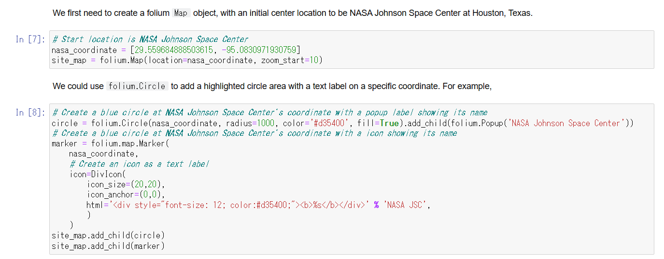
Build an Interactive Map with Folium
Finding an optimal location for building a launch site certainly involves many factors and hopefully we could discover some of the factors by analyzing the existing launch site locations.
https://github.com/nakatama225/IBM_DS_Final_Project/

Slide 14
Build a Dashboard with Matplotlib
Pie Chart and Scatter Plot
To dive deeply more the visual analytics on SpaceX launch data
* Originally, we planned to use Plotly and Dash, but since they could not be successfully executed in both cloud and local environments, we have adopted Matplotlib visualization.
https://github.com/nakatama225/IBM_DS_Final_Project/

Slide 15
Predictive Analysis (Classification)
Flowchart in this process
TASK 1: Create a NumPy array from the column Class in data, by applying the method to_numpy() then assign it to the variable Y,make sure the output is a Pandas series (only one bracket df['name of column’]).
↓
TASK 2: Standardize the data in X then reassign it to the variable X using the transform provided below.
↓
TASK 3: Use the function train_test_split to split the data X and Y into training and test data. Set the parameter test_size to 0.2 and random_state to 2. The training data and test data should be assigned to the following labels.
↓
TASK 4: Create ML model object then create a GridSearchCV object “the model”_cv with cv = 10. Fit the object to find the best parameters from the dictionary parameters.
↓
TASK 5: Calculate the accuracy on the test data using the method score of “the model” created.
Determined the best model by utilizing various modules of scikit-learn and comparing the prediction accuracy of the models.
https://github.com/nakatama225/IBM_DS_Final_Project/

Slide 16
Results
Exploratory data analysis results
Interactive analytics demo in screenshots
Predictive analysis results

Slide 17

Section 2

Slide 18
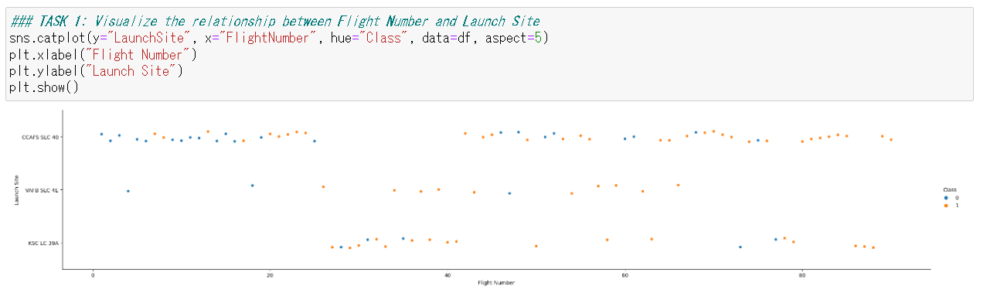
Flight Number vs. Launch Site
Regardless of site, it appears that the probability of success is higher with a greater number of flights.

Slide 19
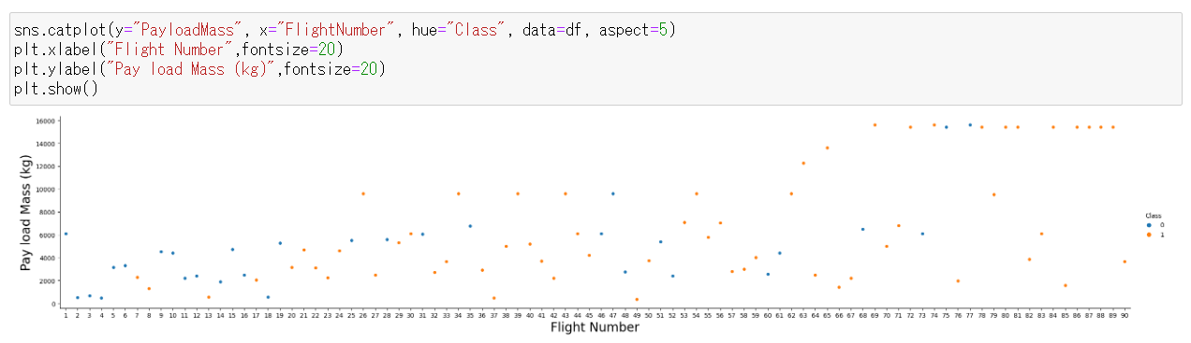
Payload vs. Launch Site
There appears to be a positive correlation.

Slide 20
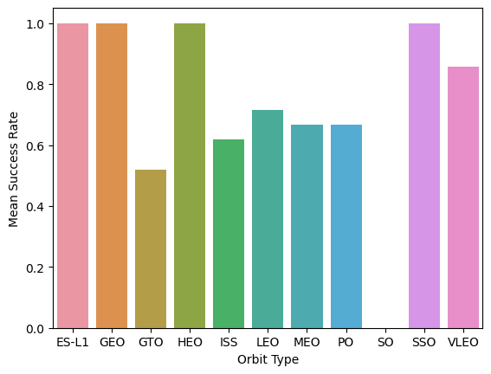
Success Rate vs. Orbit Type
There appears to be a difference in the success rate depending on the orbit type.

Slide 21
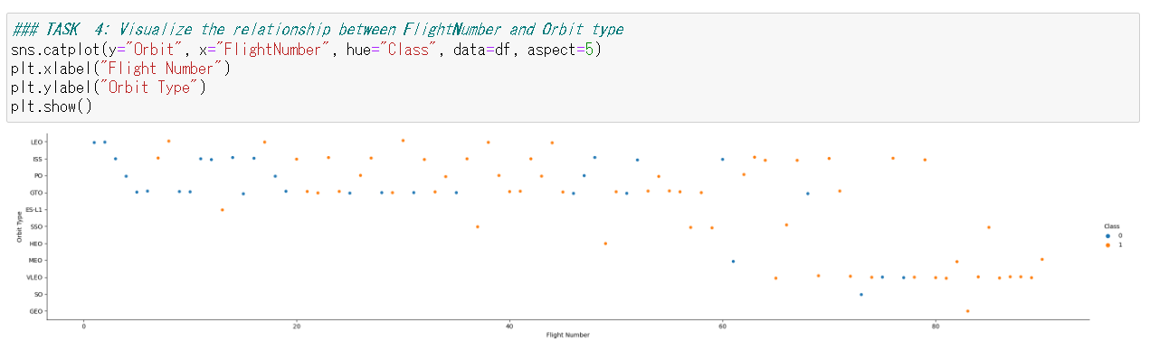
Flight Number vs. Orbit Type
Regardless of orbit type, it appears that the probability of success is higher with a greater number of flights.

Slide 22
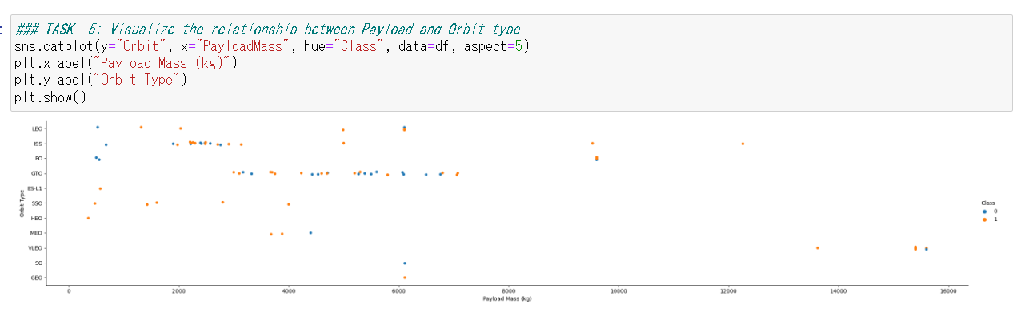
Payload vs. Orbit Type
No clear overall tendency can be seen, but there may be a tendency for each orbit type.

Slide 23
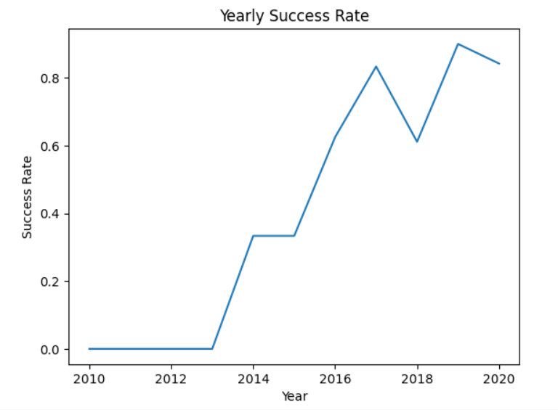
Launch Success Yearly Trend
There appears to be seen that the success rate is high as the newer years.

Slide 24
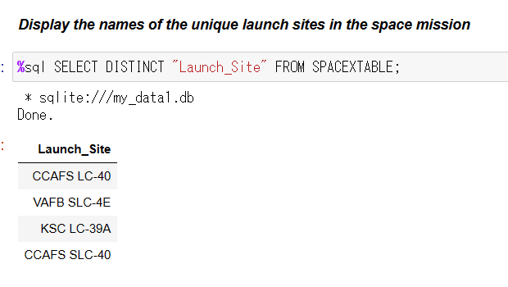
All Launch Site Names
There appears to be seen four main launch sites.

Slide 25
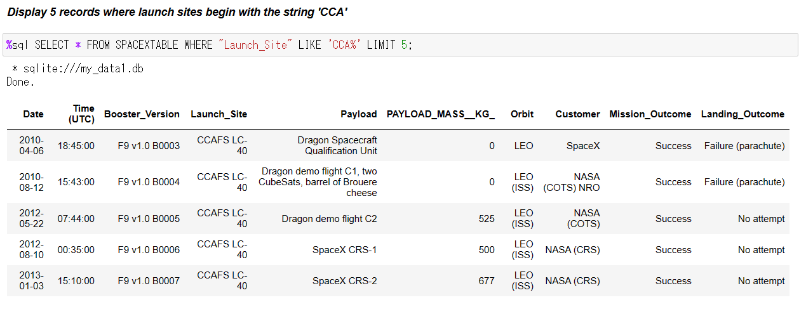
Launch Site Names Begin with 'CCA'
As the figure shows.

Slide 26
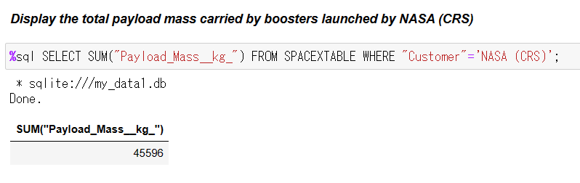
Total Payload Mass
As the figure shows.

Slide 27
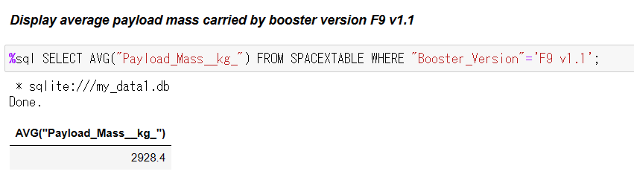
Average Payload Mass by F9 v1.1
As the figure shows.

Slide 28
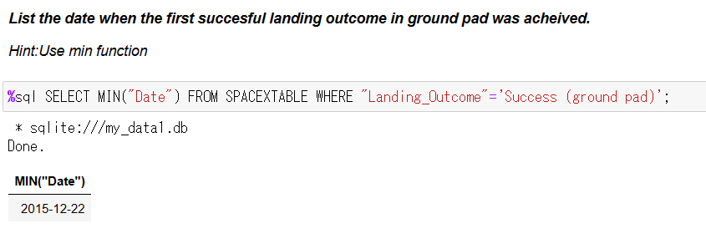
First Successful Ground Landing Date
As the figure shows.

Slide 29
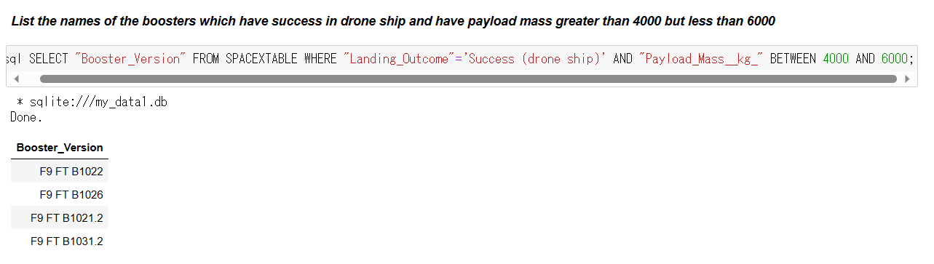
Successful Drone Ship Landing with Payload between 4000 and 6000
Regarding Drone Ship Landing with Payload between 4000 and 6000, there appears to be seen that the Booster version starting with "F9 FT B10" is extracted.

Slide 30
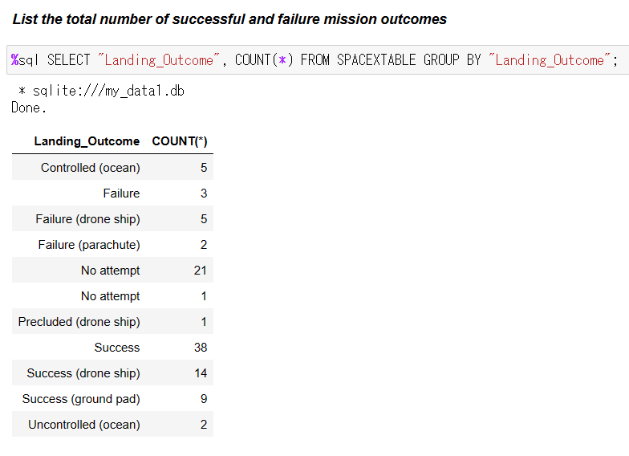
Total Number of Successful and Failure Mission Outcomes
When success and failure are compared, it appears that success is more common.
Also, there appears to be that No attempt is seen not quite a few.

Slide 31
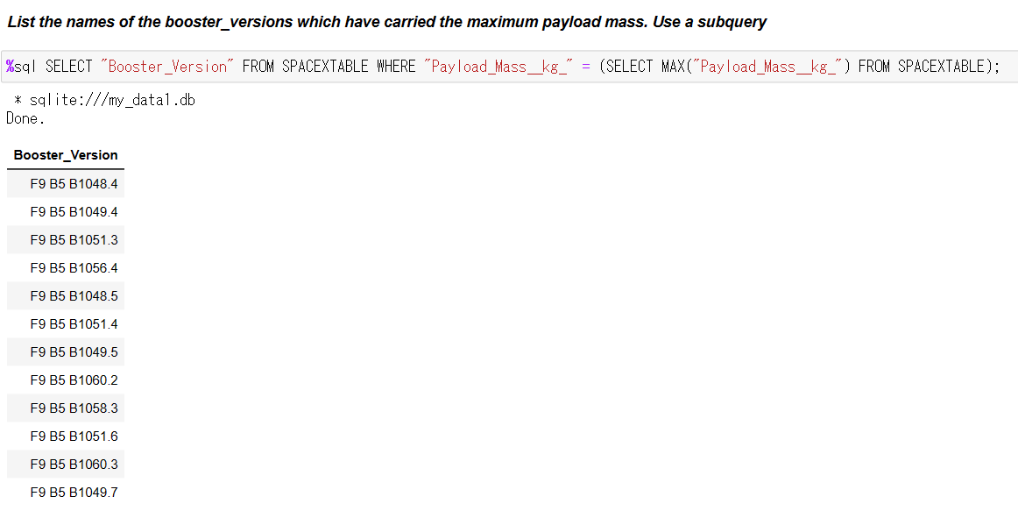
Boosters Carried Maximum Payload
As a result, there appears to be seen that the Booster version starting with "F9 B5 B10" is extracted.

Slide 32
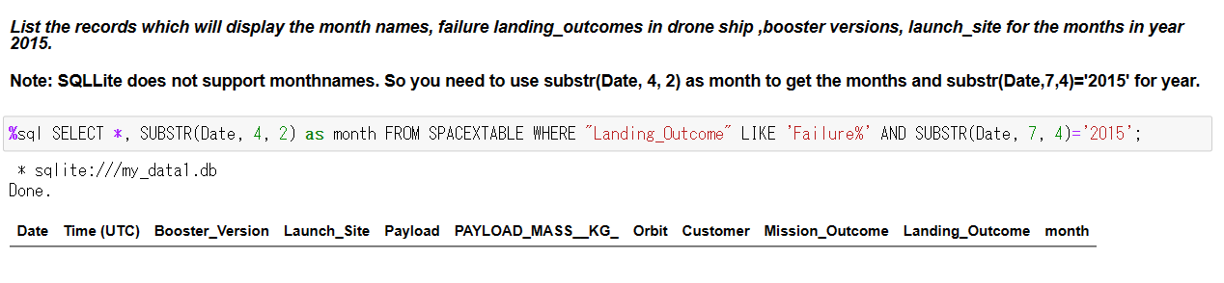
2015 Launch Records
As the figure shows, the result number of data is zero.

Slide 33
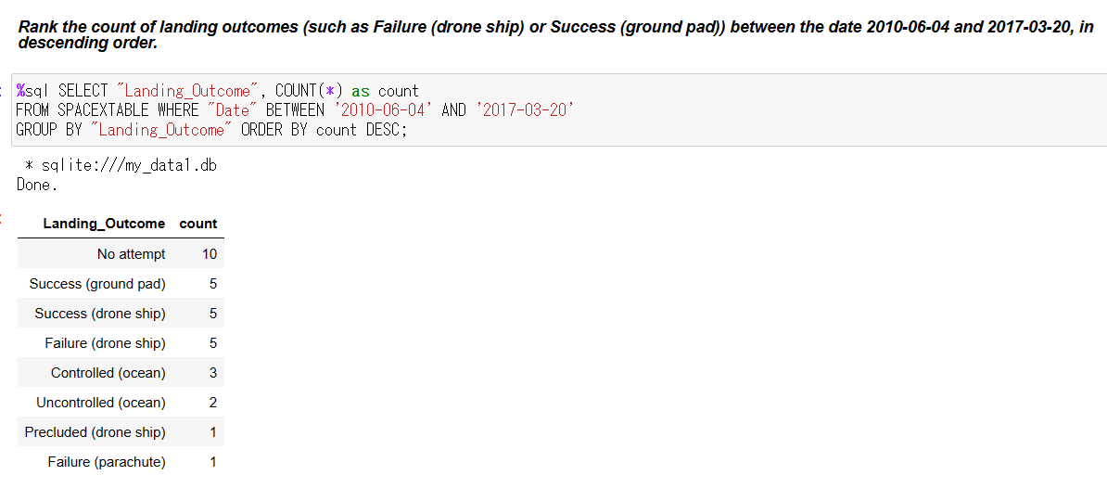
Rank Landing Outcomes Between 2010-06-04 and 2017-03-20
There appears to be seen that No attempt is the highest number in this query conditions.

Slide 34

Section 3

Slide 35
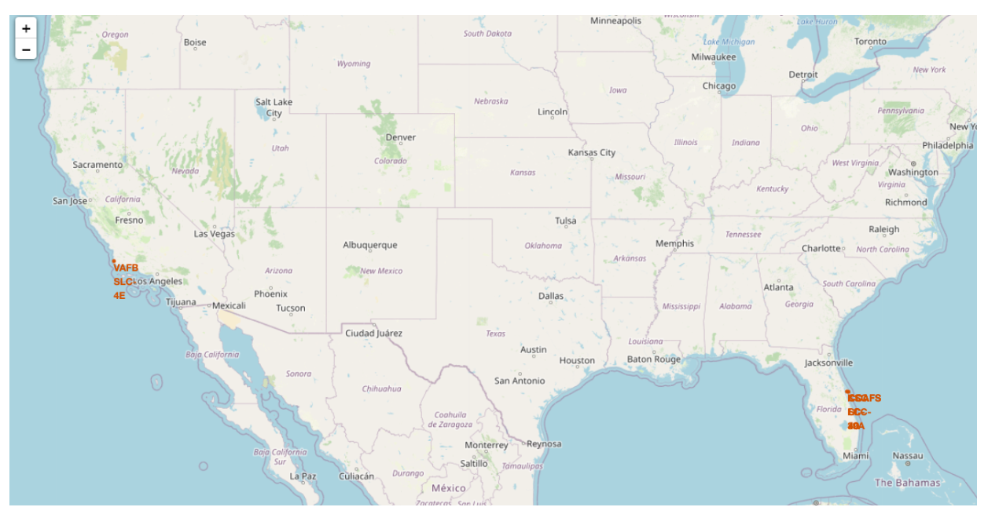
All launch sites on a global map
It can be seen that the launch sites are located on the west and east coasts respectively.

Slide 36
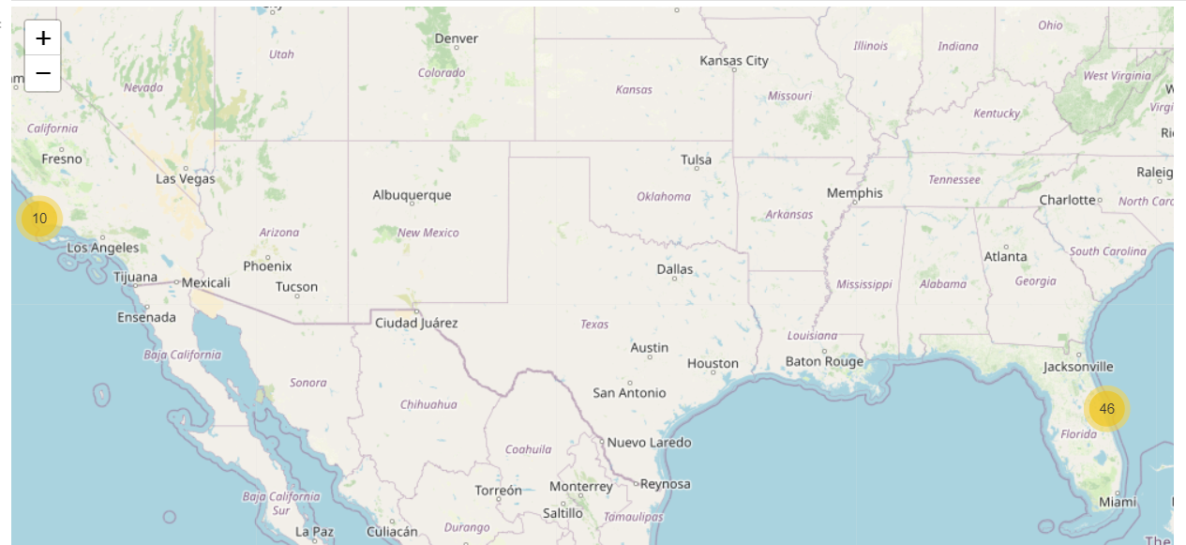
All launch sites count on a global map
It can be seen that there are 46 data points on the East Coast and 10 on the West Coast.

Slide 37
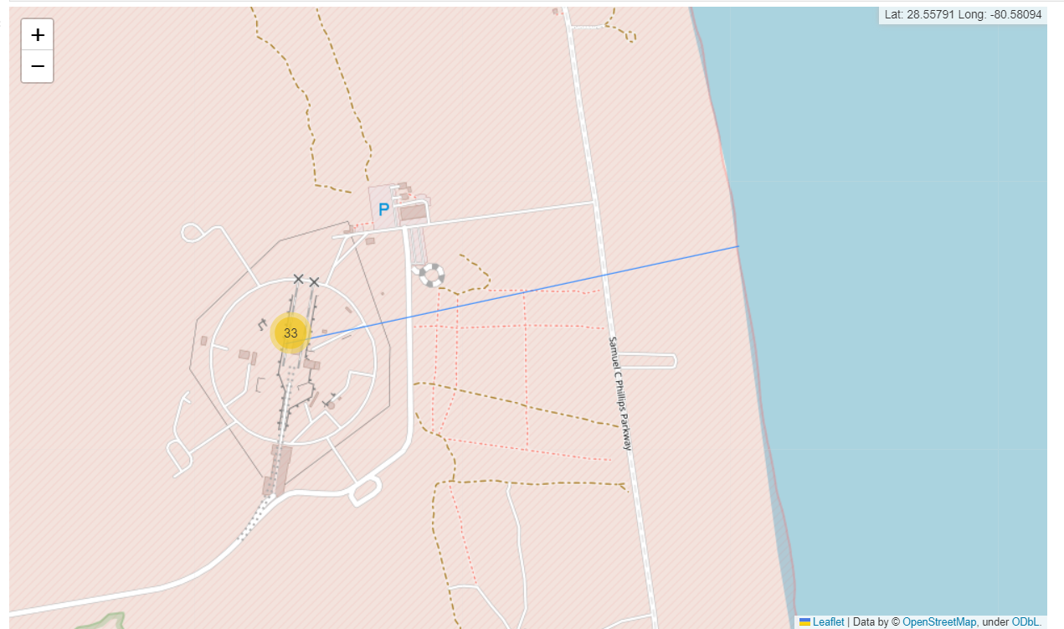
Straight line from 33 data points on the East Coast to the nearest coastline
It can be seen that a straight line from 33 data points on the East Coast to the nearest coastline.

Slide 38

Section 4

Slide 39
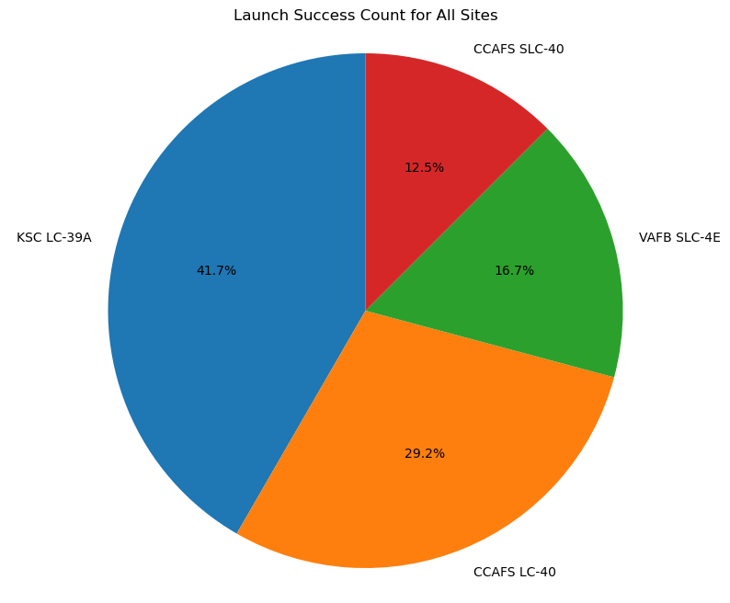
Launch success count for all sites
It can be seen that "KSC LC-39A" accounts for 40% of the total.

Slide 40
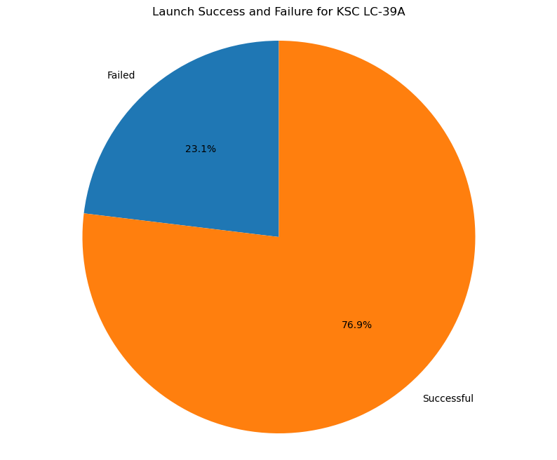
Piechart for the launch site with highest launch success ratio
In "KSC LC-39A“, it can be seen that more than 70% succeeded.

Slide 41
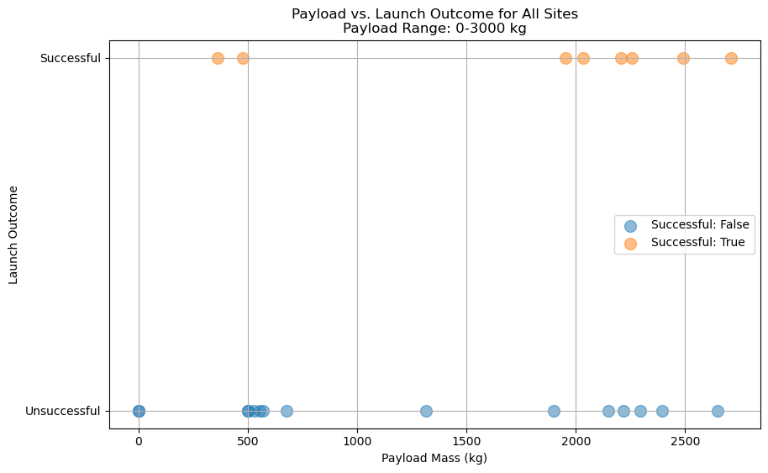
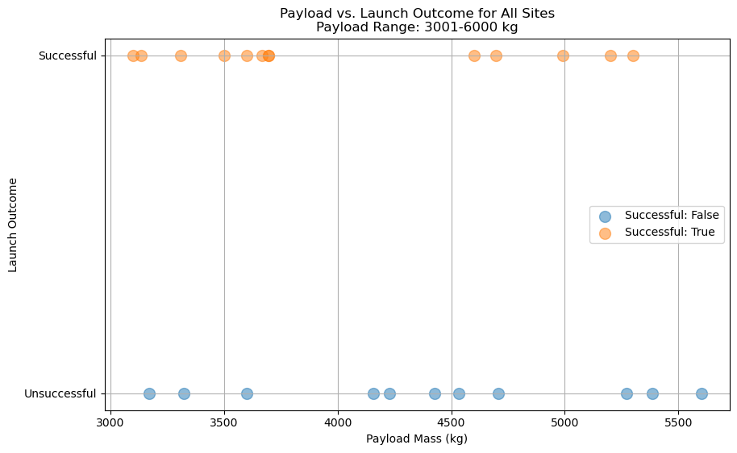
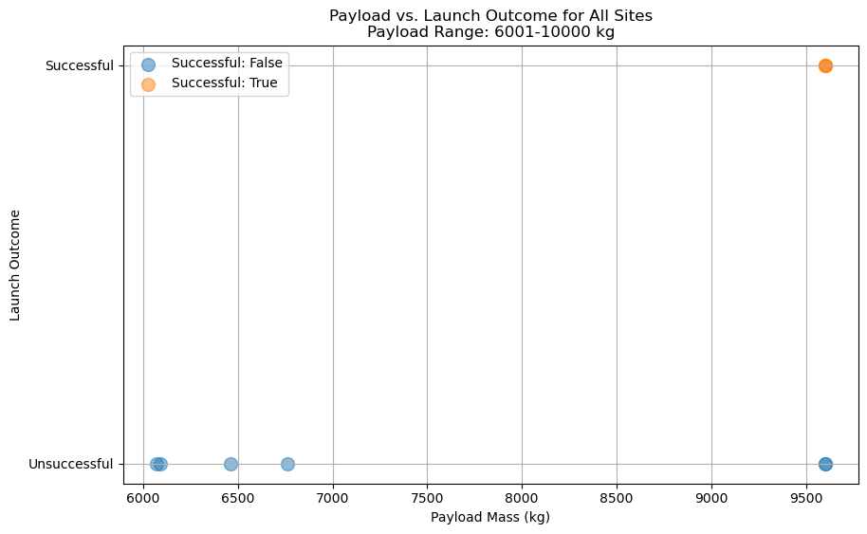
Payload vs. Launch Outcome for different payload ranges
It can be seen that the higher the Payload Mass, the more a little likely it is to be successful.
It can be seen that the lower the Payload Mass, the more a little likely it is to be successful.
It can be seen that it is difficult to succeed regardless of Payload Mass.

Slide 42

Section 5

Slide 43
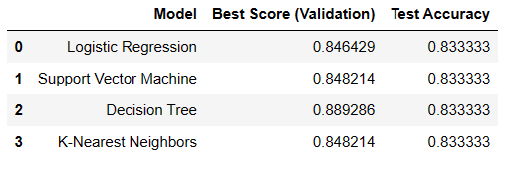
Classification Accuracy
It can be seen that the decision tree model had the highest score among the models executed in this project.

Slide 44
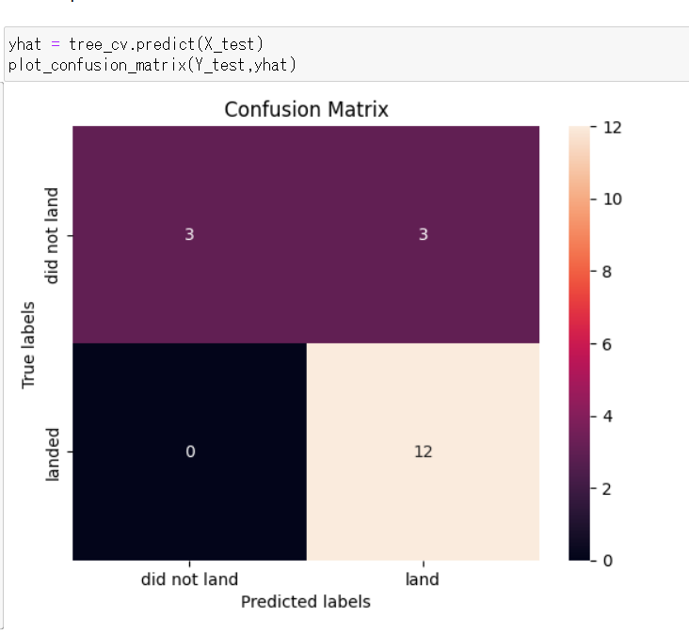
Confusion Matrix
It can be seen that the overall prediction accuracy is high, and in this test data, the actual successful data is accurately predicted.

Slide 45
Conclusions
Within the scope of the data set in this project, the prediction by the decision tree model was found to be effective.
Applying these model predictions to future launch projects would allow for the calculation of expected costs associated with success or failure.
On the other hand, for future issues, it should be noted that the data sample size for this project is not necessarily large and that a statistically detailed analysis has not been conducted.

Slide 46
Appendix
Include any relevant assets like Python code snippets, SQL queries, charts, Notebook outputs, or data sets that you may have created during this project
https://github.com/nakatama225/IBM_DS_Final_Project/

Slide 47


